Slide 1


FAIR Data Management for ground-
and excited-state calculations
José M. (Chema) Pizarro
jose.pizarro@physik.hu-berlin.de
@ JosePizarroB
https://nomad-lab.eu/nomad-lab/
https://www.fairmat-nfdi.eu/fairmat/

Slide 2
Schedule
Introduction to Research Data Management in Materials Science
FAIRmat and the NOMAD Archive & Repository
Hands-on NOMAD

Slide 3
Schedule
Introduction to Research Data Management in Materials Science
FAIRmat and the NOMAD Archive & Repository
Hands-on NOMAD

Slide 4


Introduction to RDM in Materials Science
Why is RDM important?
Key for verifiability, reproducibility and transparency of scientific results: an important anti-fraud mechanism.

Slide 5
Introduction to RDM in Materials Science
Why is RDM important?
Key for verifiability, reproducibility and transparency of scientific results: an important anti-fraud mechanism.
Reduction of scientific errors.
Faster retrieval of data and information for reusability → AI and Machine-Learning predictions.
Prevents data loss, allowing long-term availability.
Important to get funding…

Slide 6








Introduction to RDM in Materials Science
When and how to prepare a RDM plan?
The data life cycle → describes the lifespan of the data → following this cycle directly improves your research on the short and the long term.
No need to reinvent the wheel, but actually build on existing infrastructure → several databases for Materials Science data:

Slide 7
F.A.I.R. principles
Raw data vs Metadata
Data that explains the data → makes raw data understandable.
Makes data searchable.
Human- and Machine-readable → metadata schemas are pairs of `key: value` (dictionaries).

Slide 8
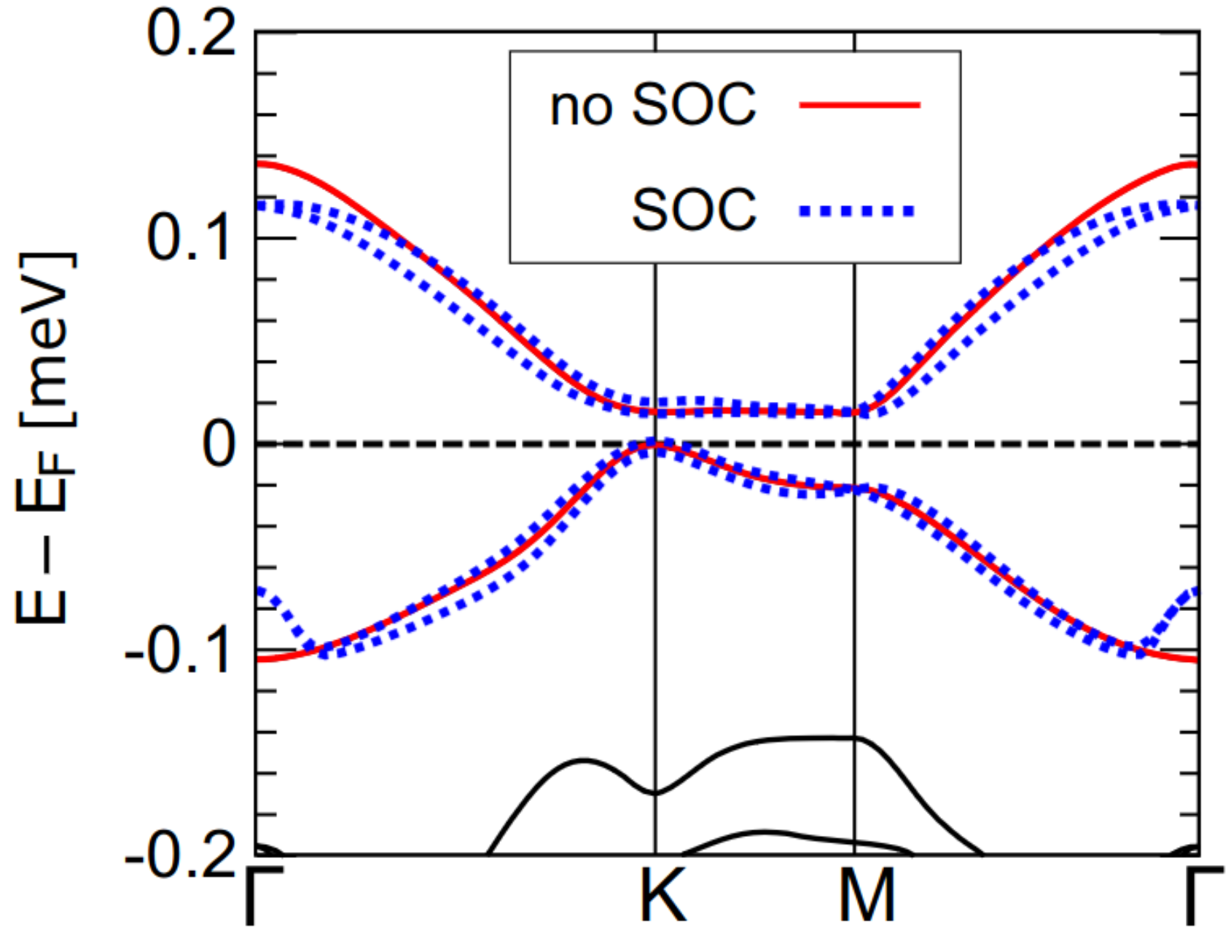
F.A.I.R. principles
Raw data vs Metadata
Let’s see an example:
J.M. Pizarro et al, npj Quantum Materials 5 (2020)

Slide 9
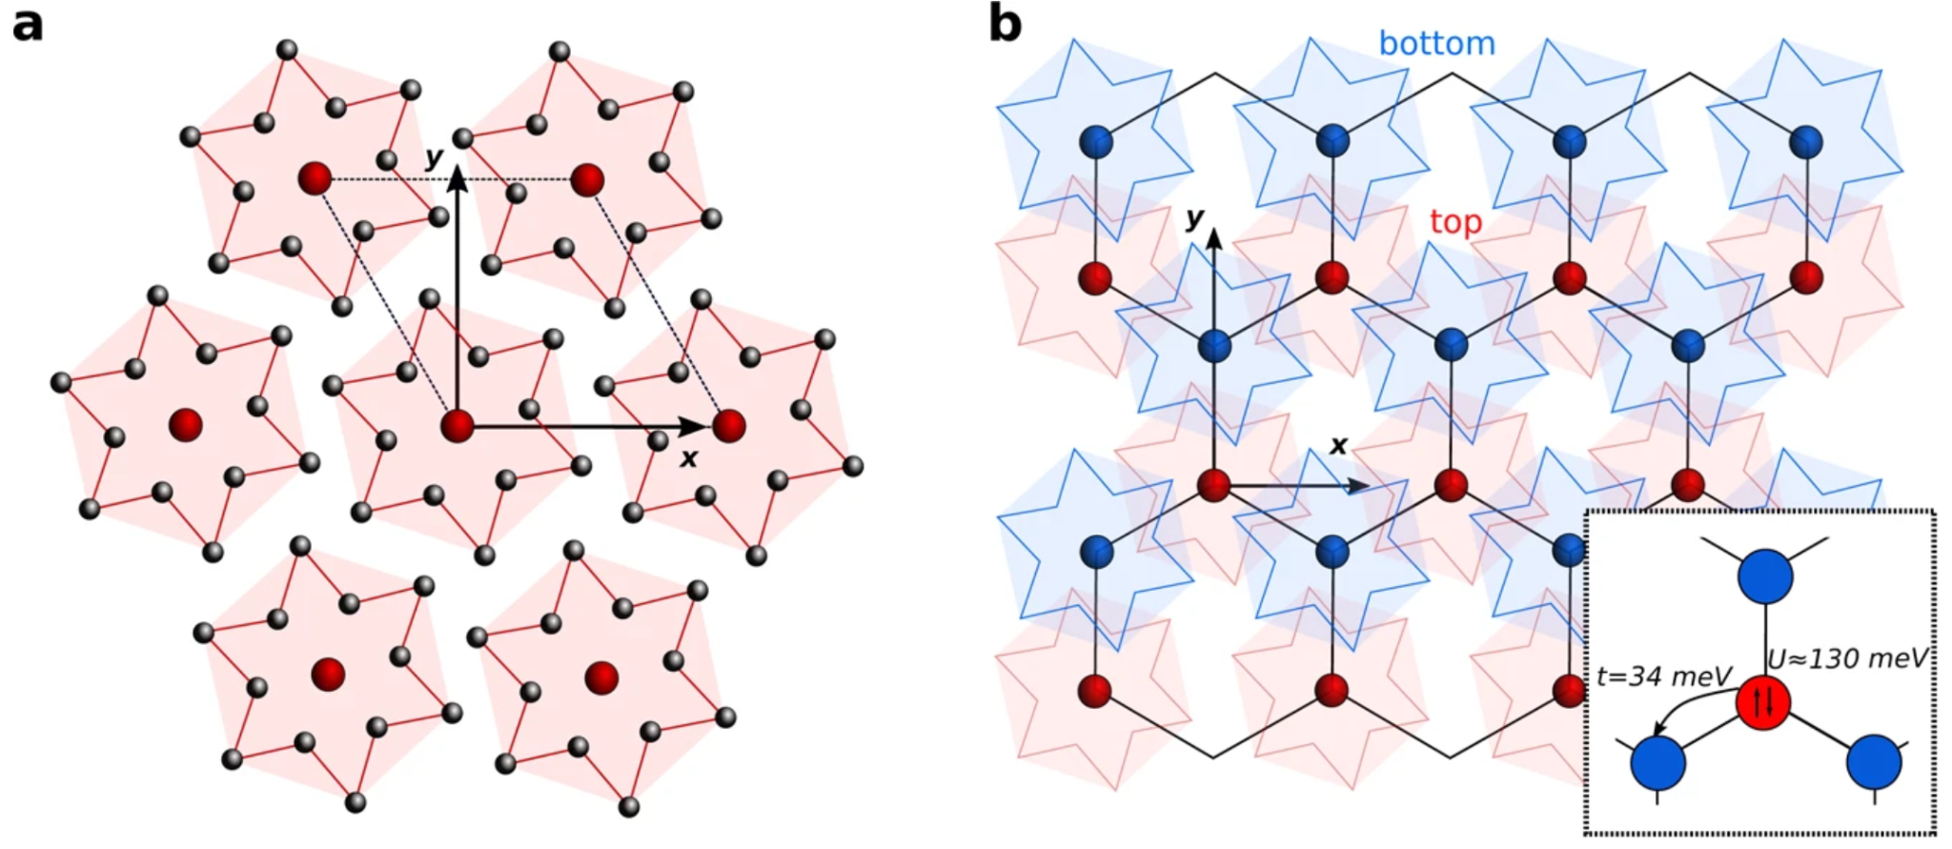
J.M. Pizarro et al, npj Quantum Materials 5 (2020)

Slide 10
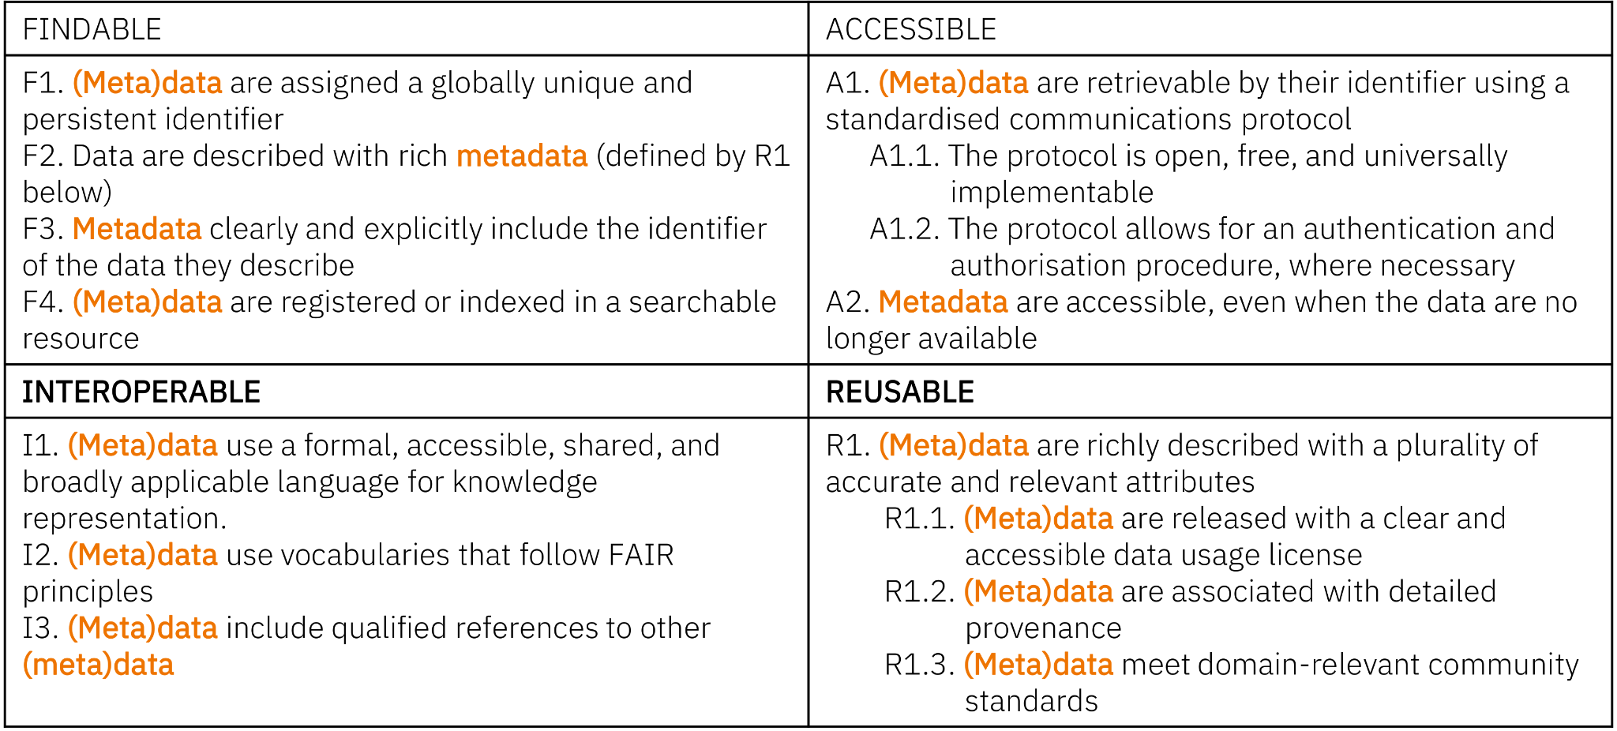
F.A.I.R. principles
https://www.go-fair.org/fair-principles/

Slide 11
F.A.I.R. principles
F: metadata should be easy to find for humans and computers: descriptive.
A: users need to have easy access the metadata (by authentication / authorisation).
I: integration with other types of data: controlled vocabulary.
R: reusability of metadata in different settings: detailed provenance, domain community standards.
It has also an alternative meaning: Findable and AI-Ready.

Slide 12
Schedule
Introduction to Research Data Management in Materials Science
FAIRmat and the NOMAD Archive & Repository
Hands-on NOMAD

Slide 13
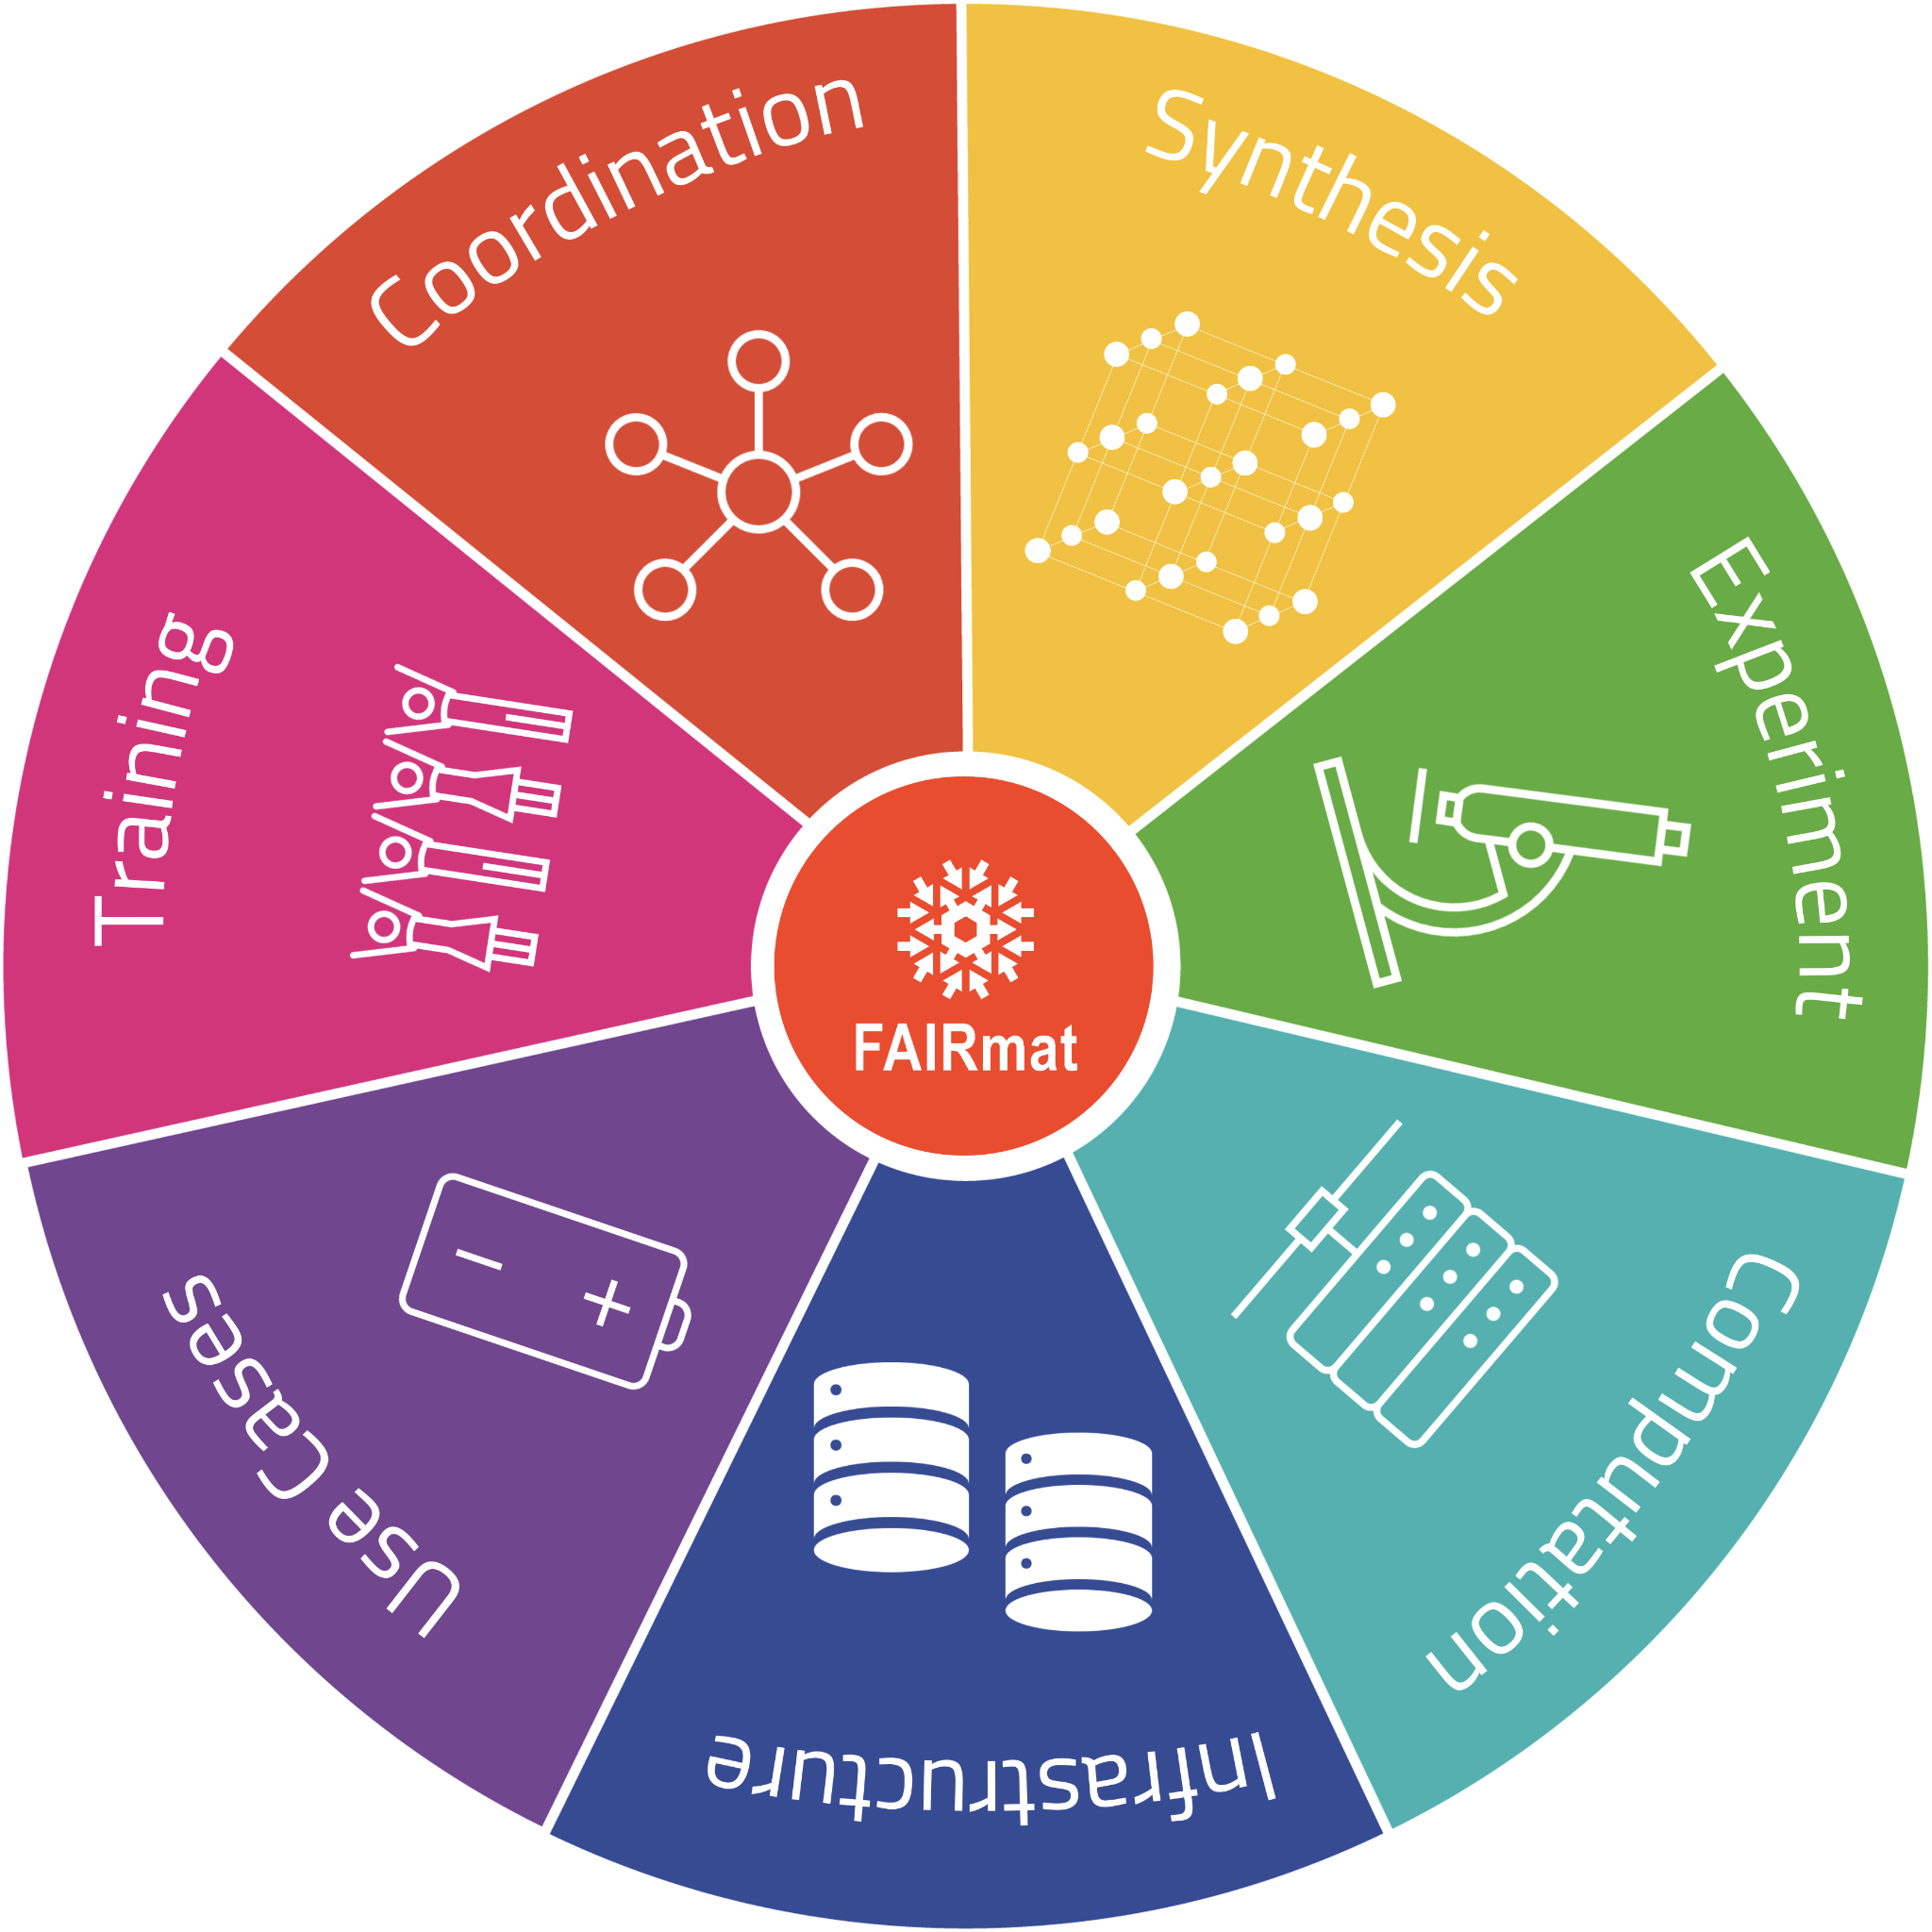
FAIRmat
Building a FAIR data infrastructure for Materials Science research data using the NOMAD Archive & Repository.
New project (started funding 2021, until 2026 plus 5 years more extension) under the NFDI (“Nationale Forschungsdaten Infrastruktur”), Germany.

Slide 14
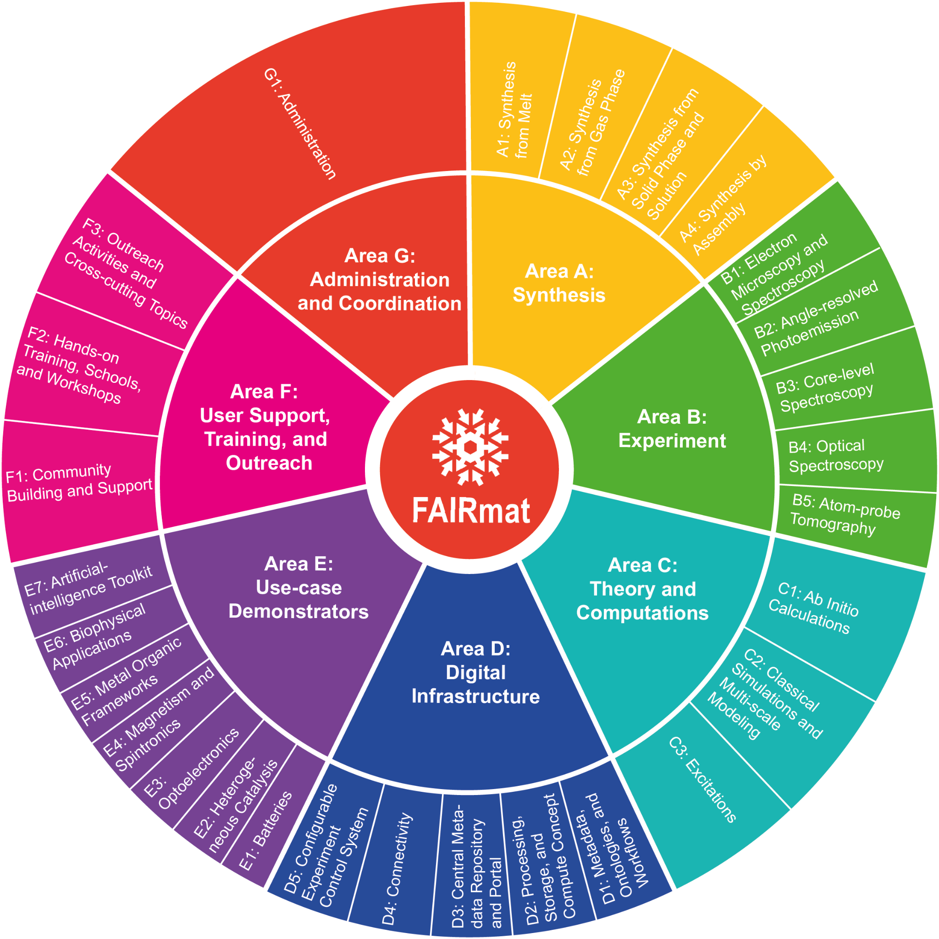
FAIRmat
Building a FAIR data infrastructure for Materials Science research data using the NOMAD Archive & Repository.
Huge team and community-driven effort.

Slide 15
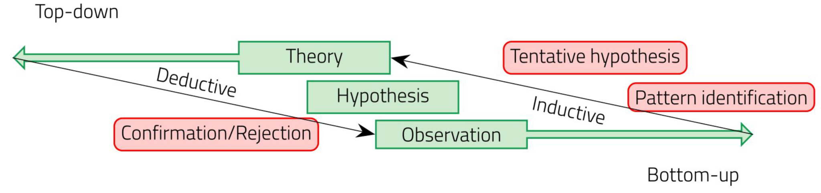
FAIRmat
Building a FAIR data infrastructure for Materials Science research data using the NOMAD Archive & Repository.
NOMAD started in 2014 with DFT data → current effort is focused on extending the infrastructure and build Interoperability across “Areas”.
Defining metadata schemas for Materials Science Synthesis, Characterization, and Computational data

Slide 16
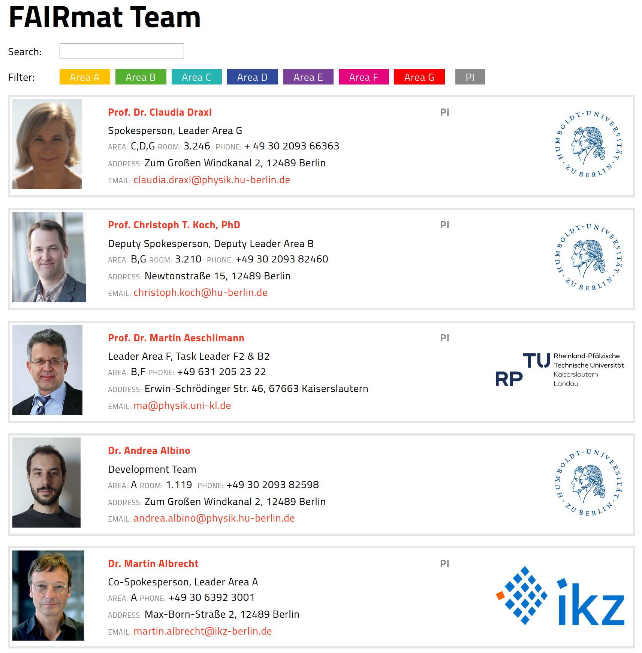
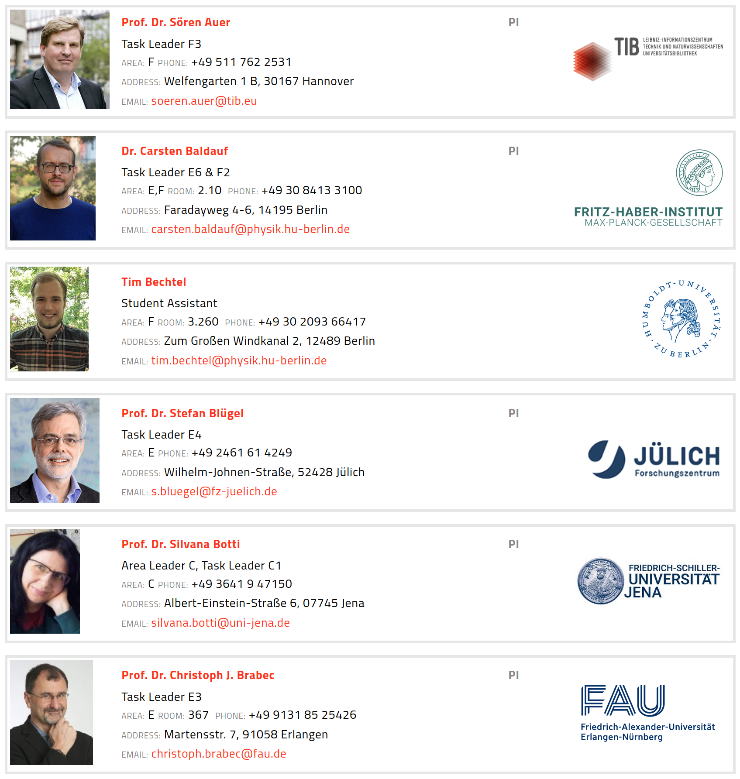
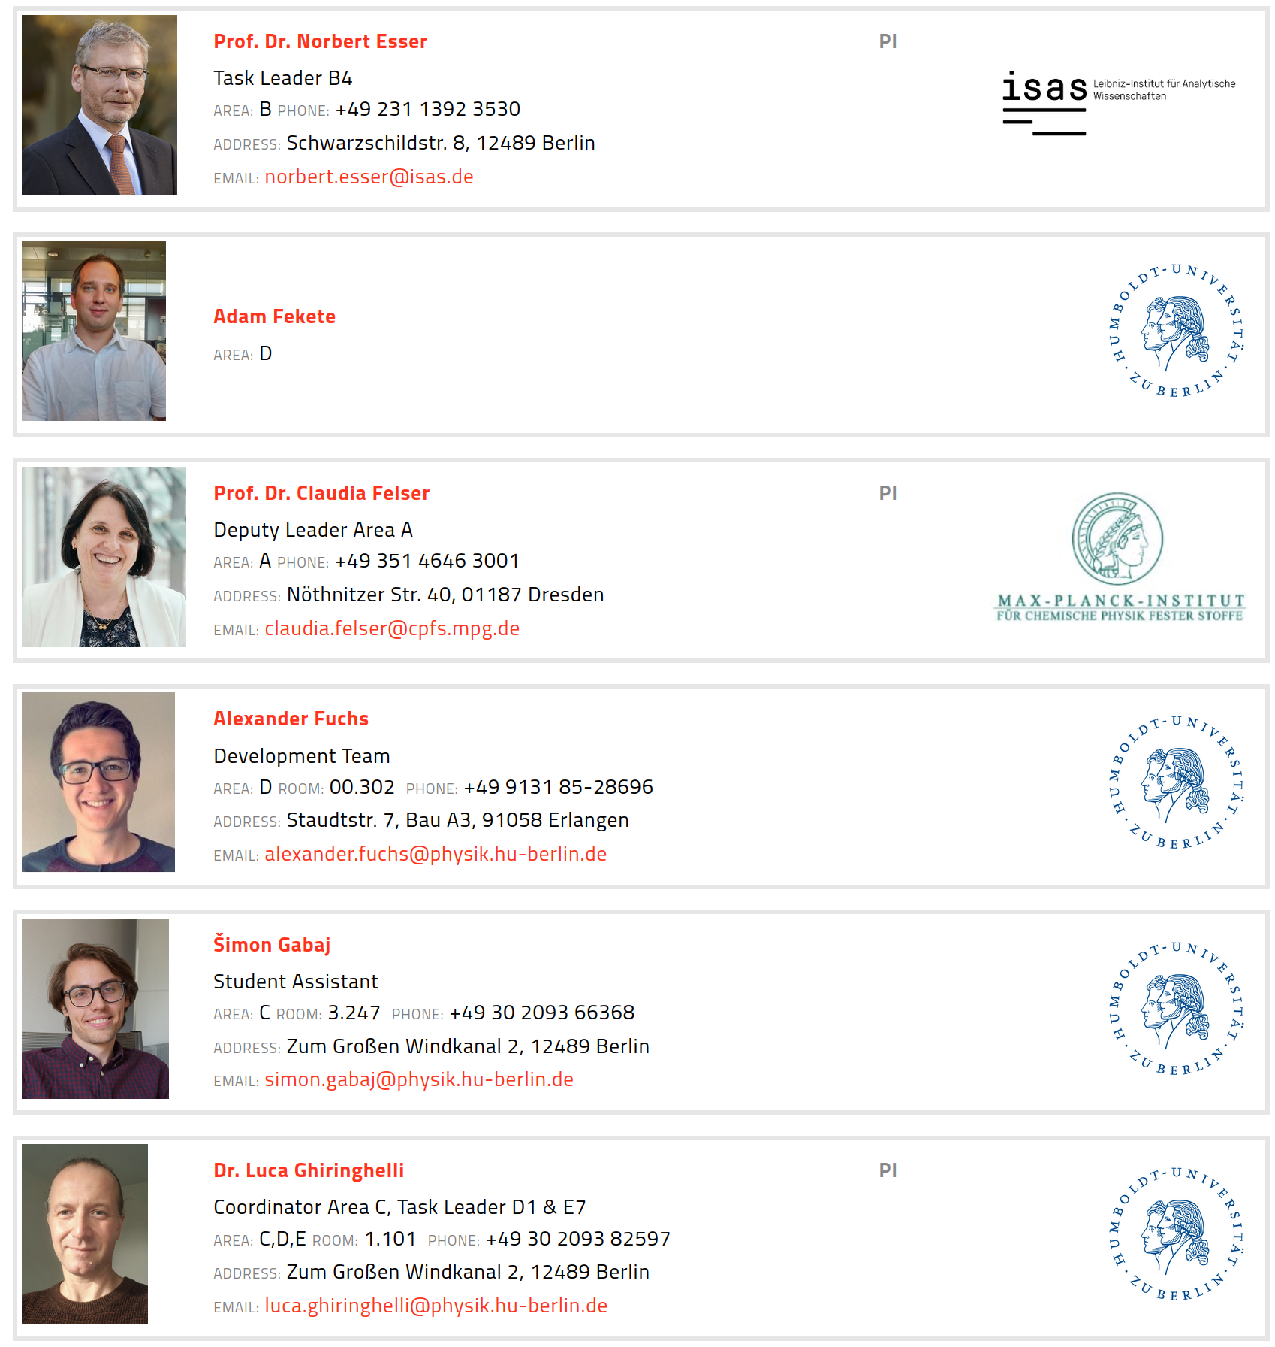
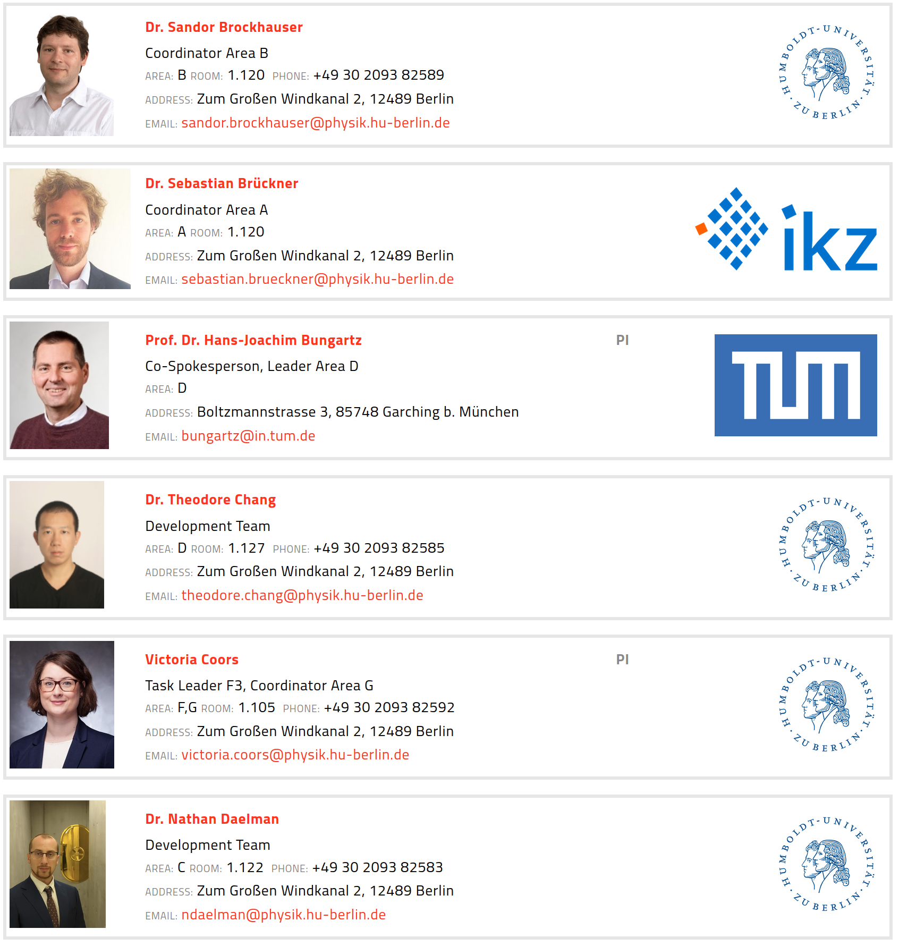
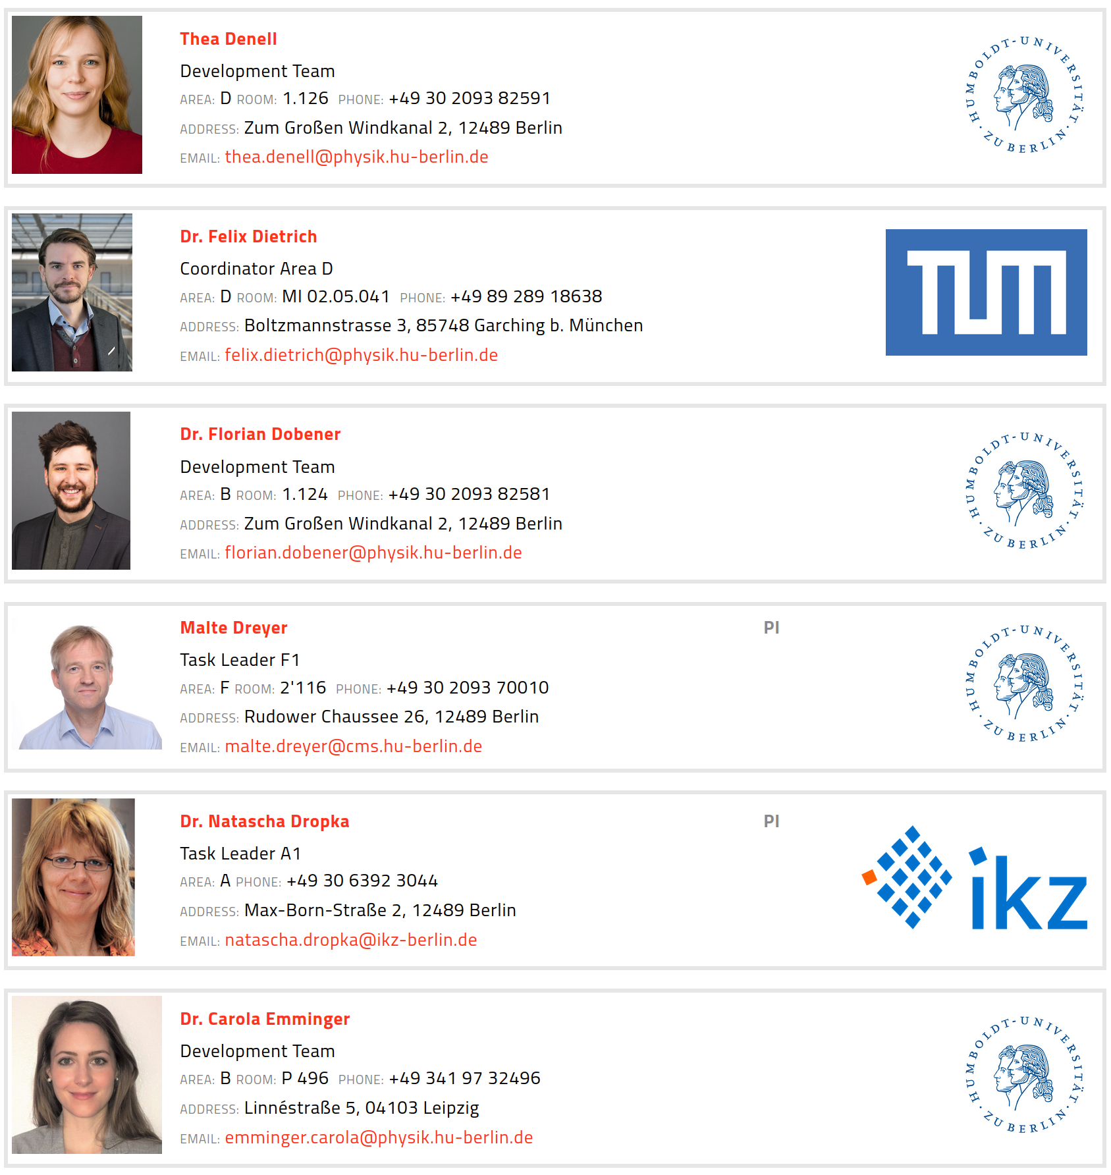
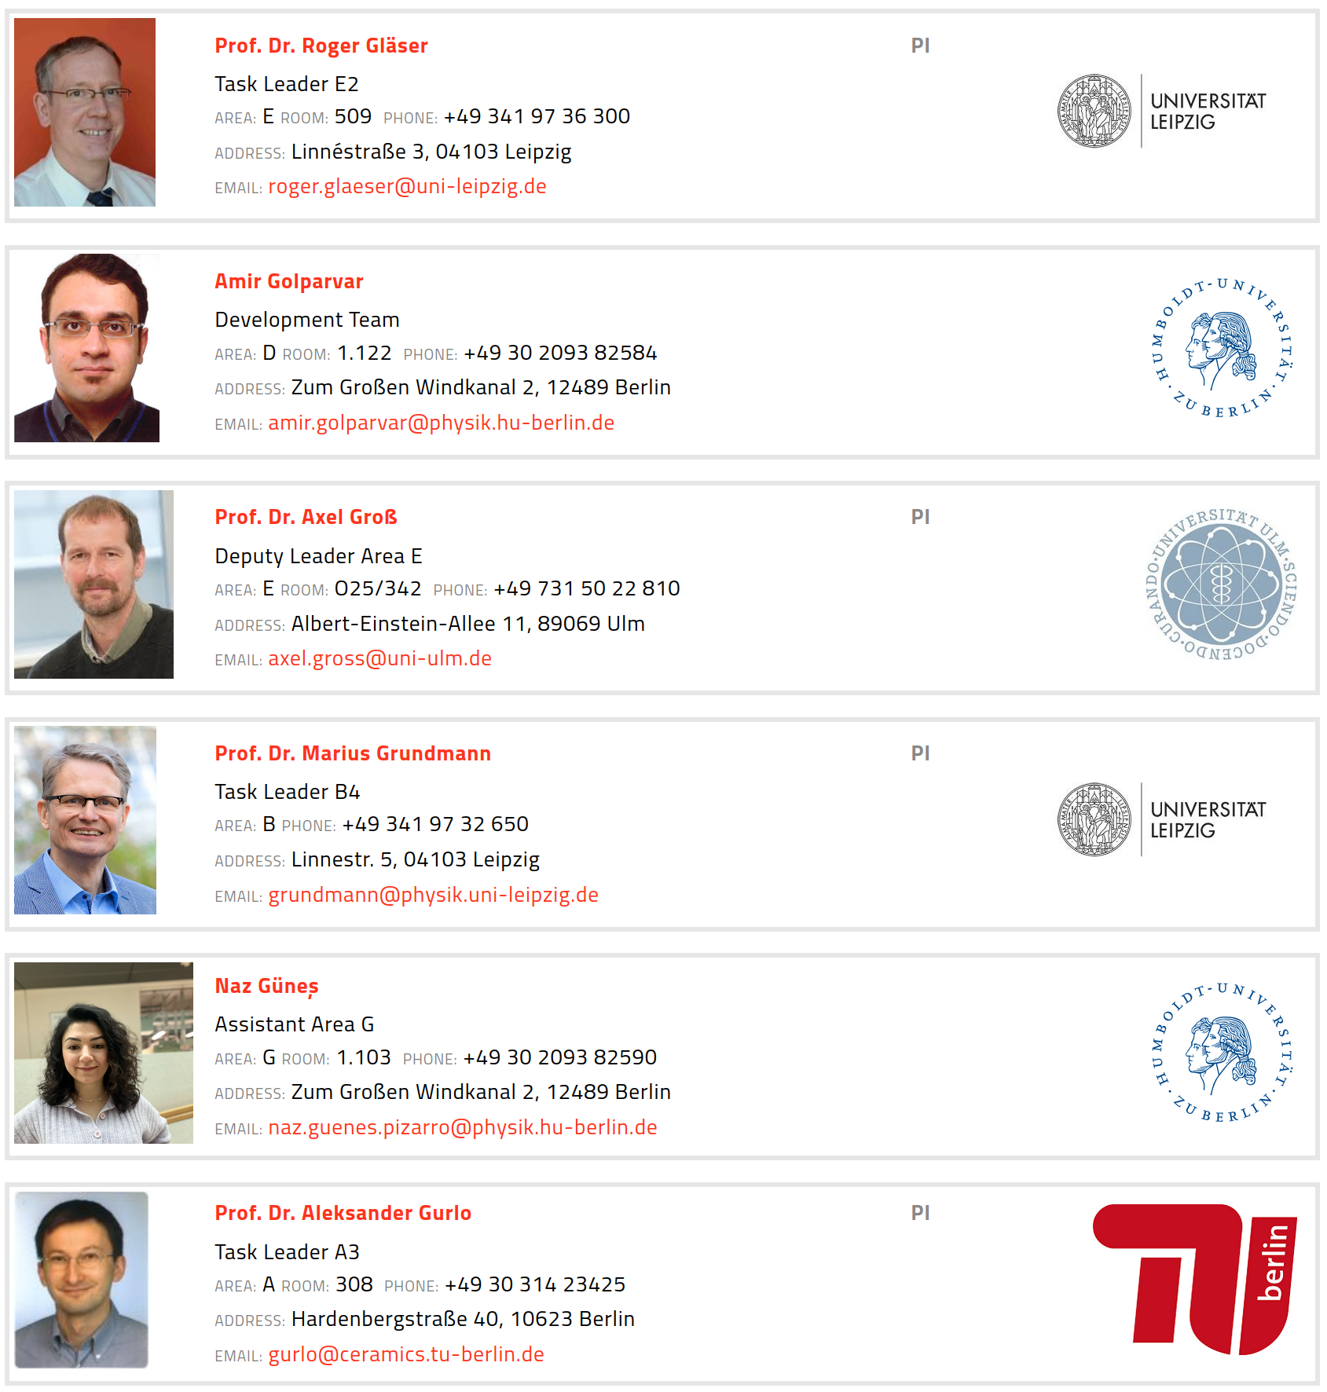
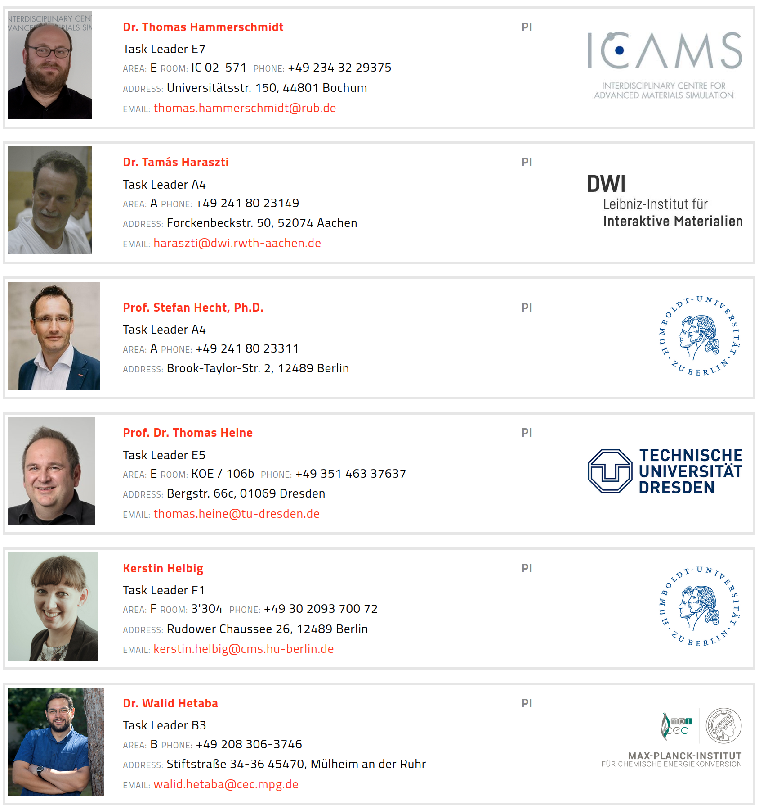
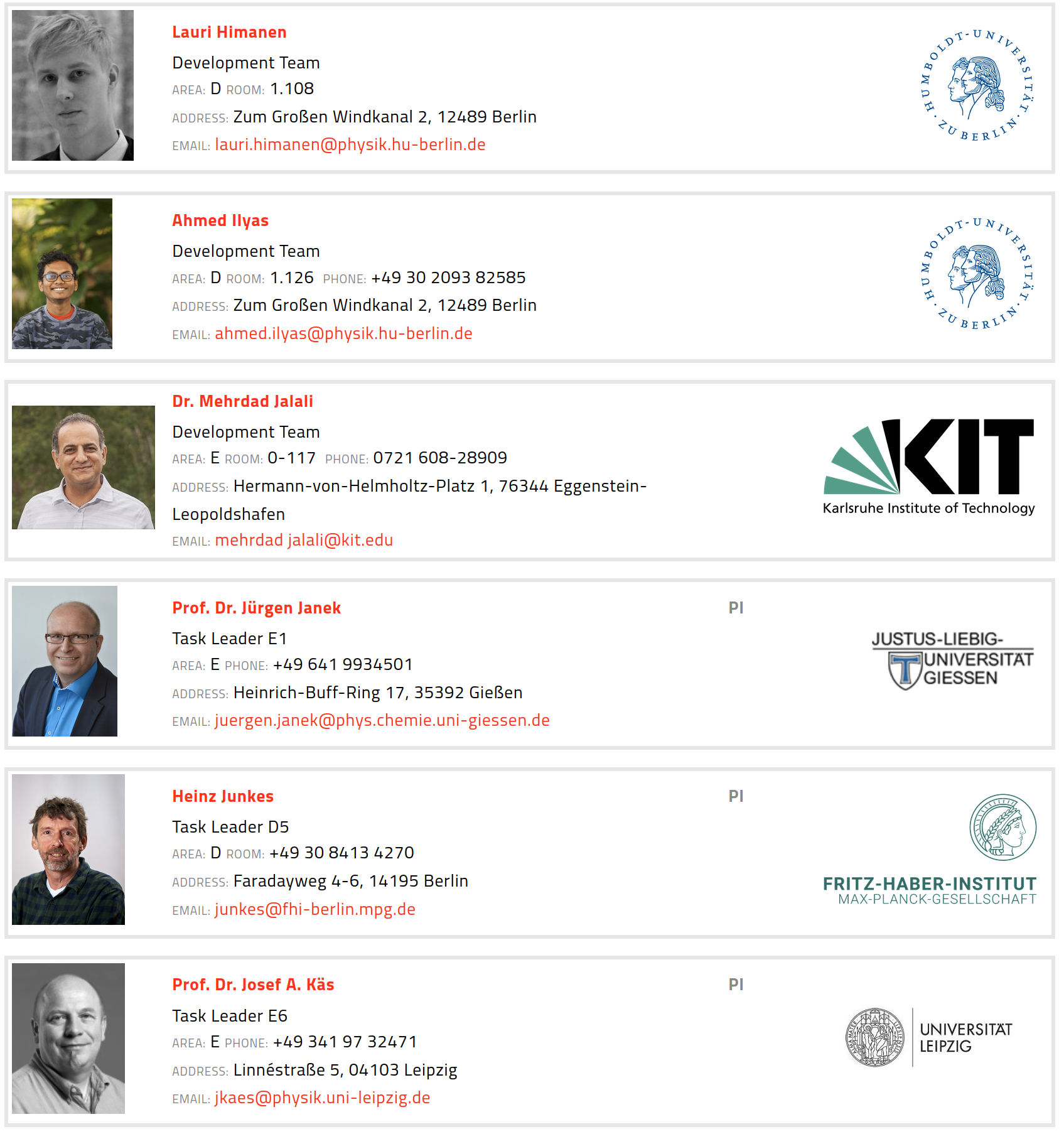
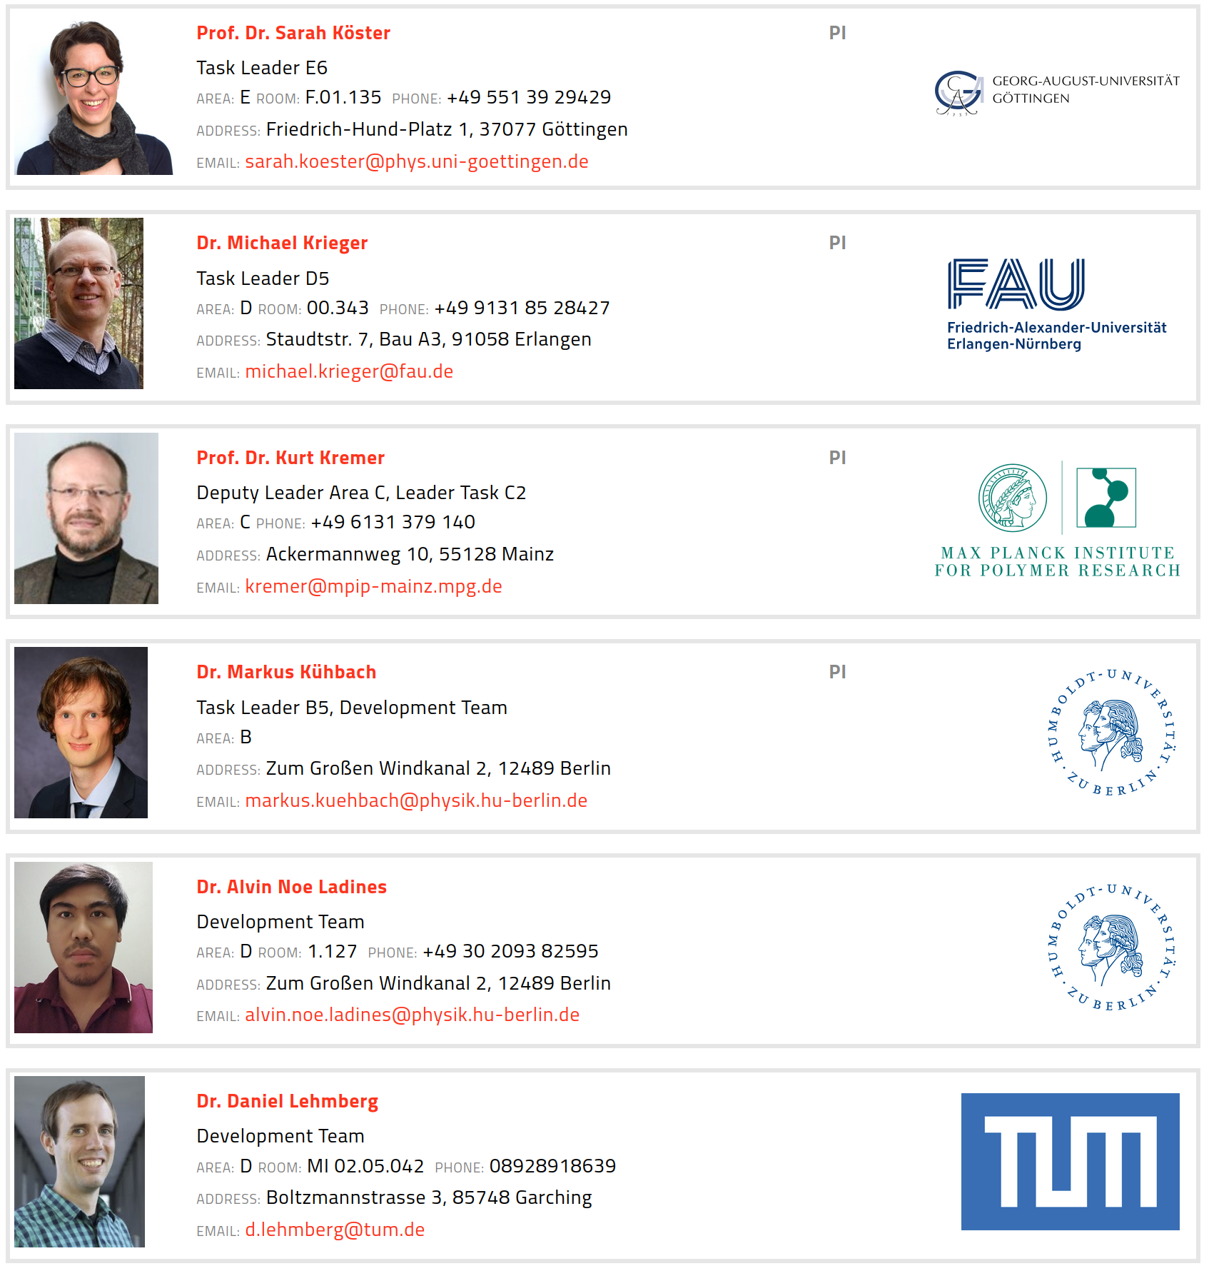
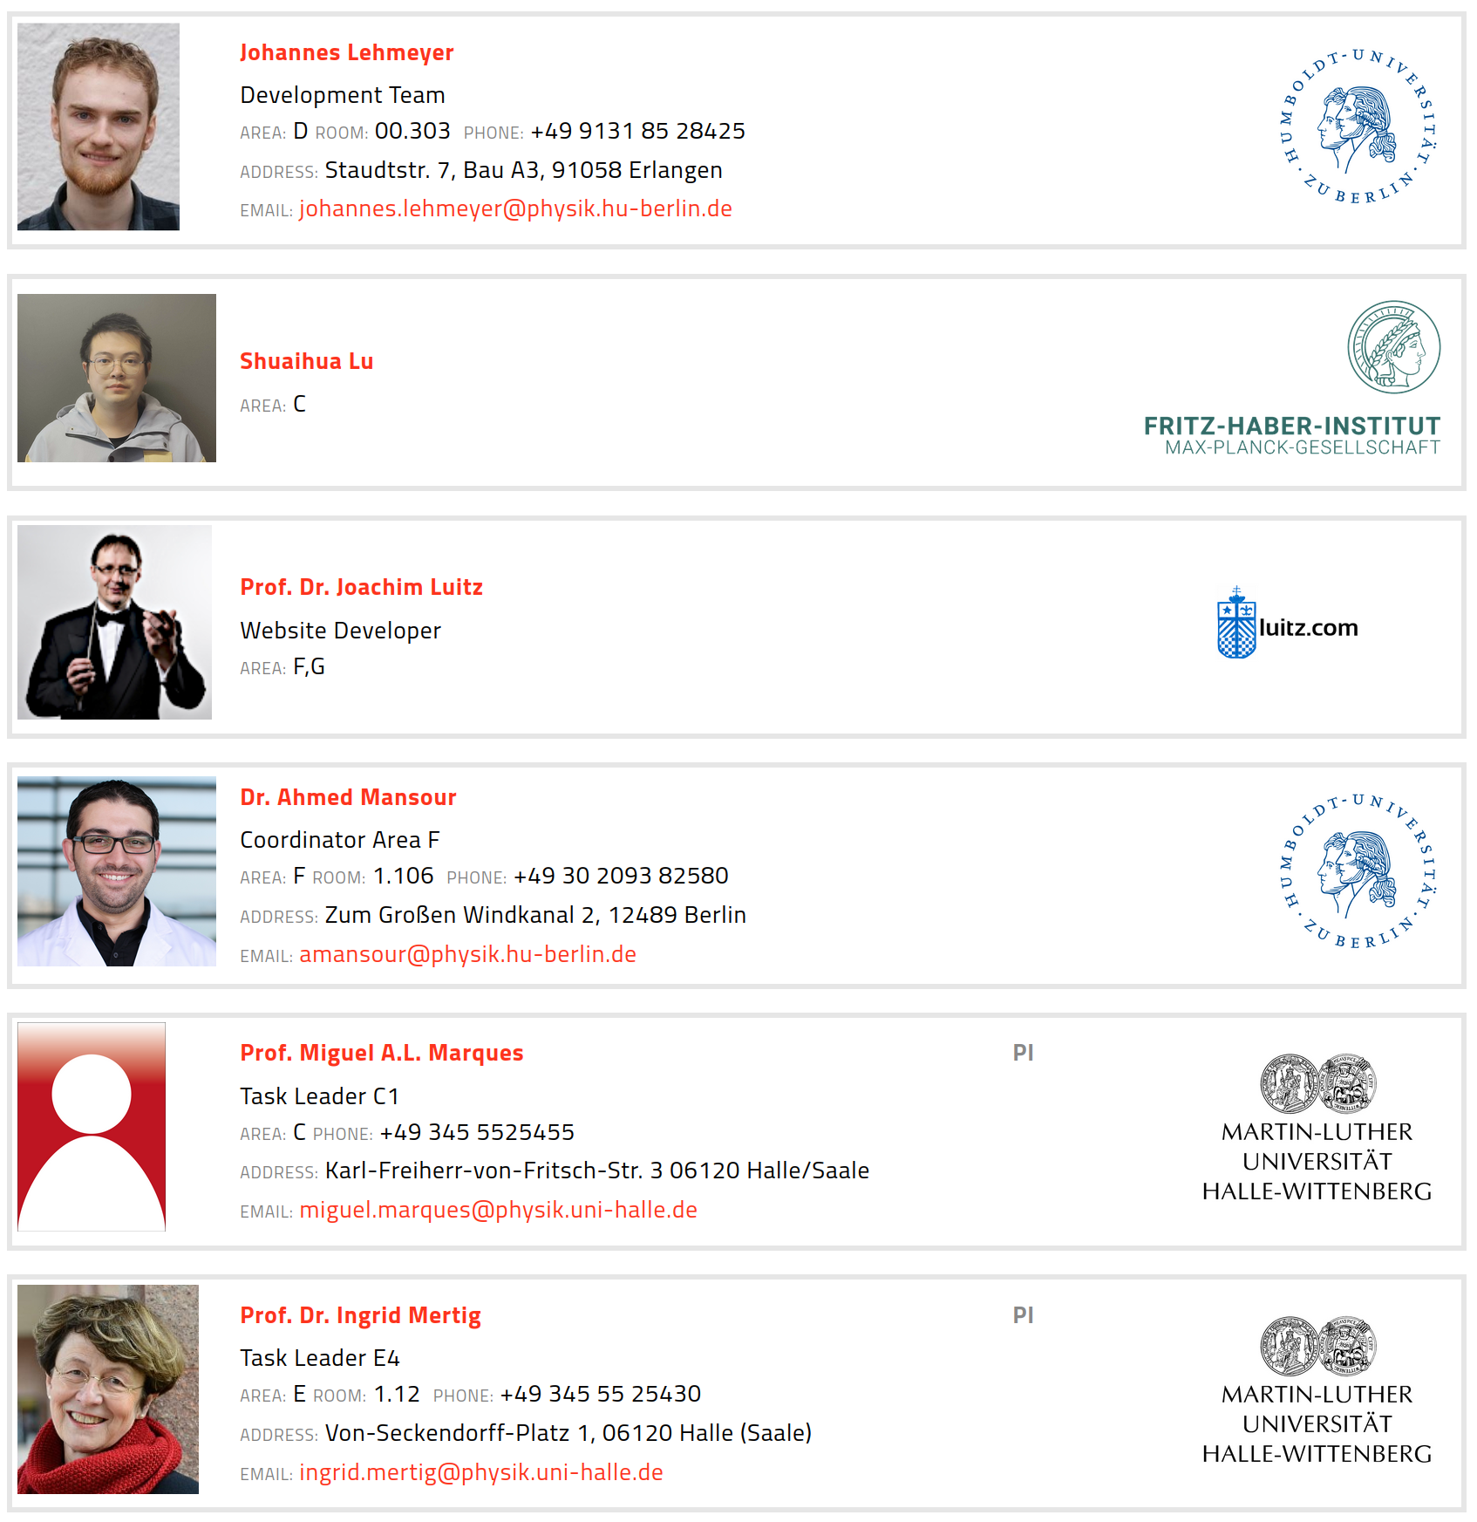
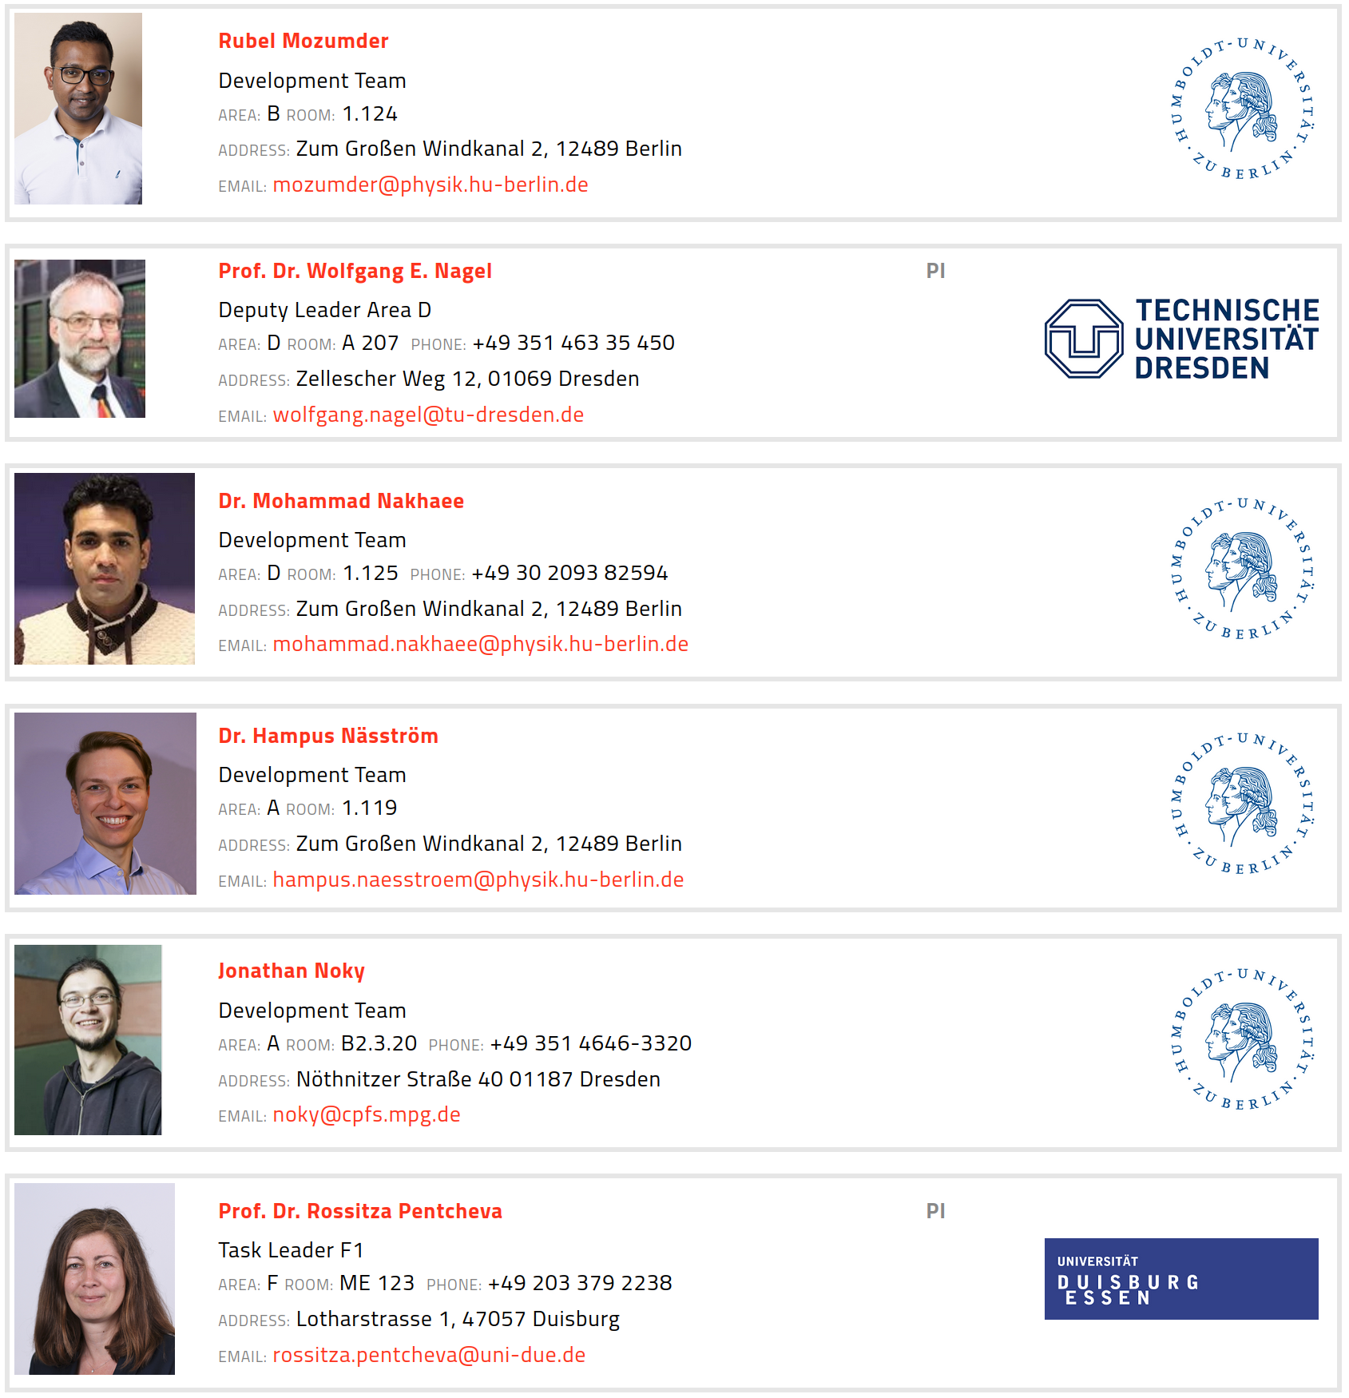
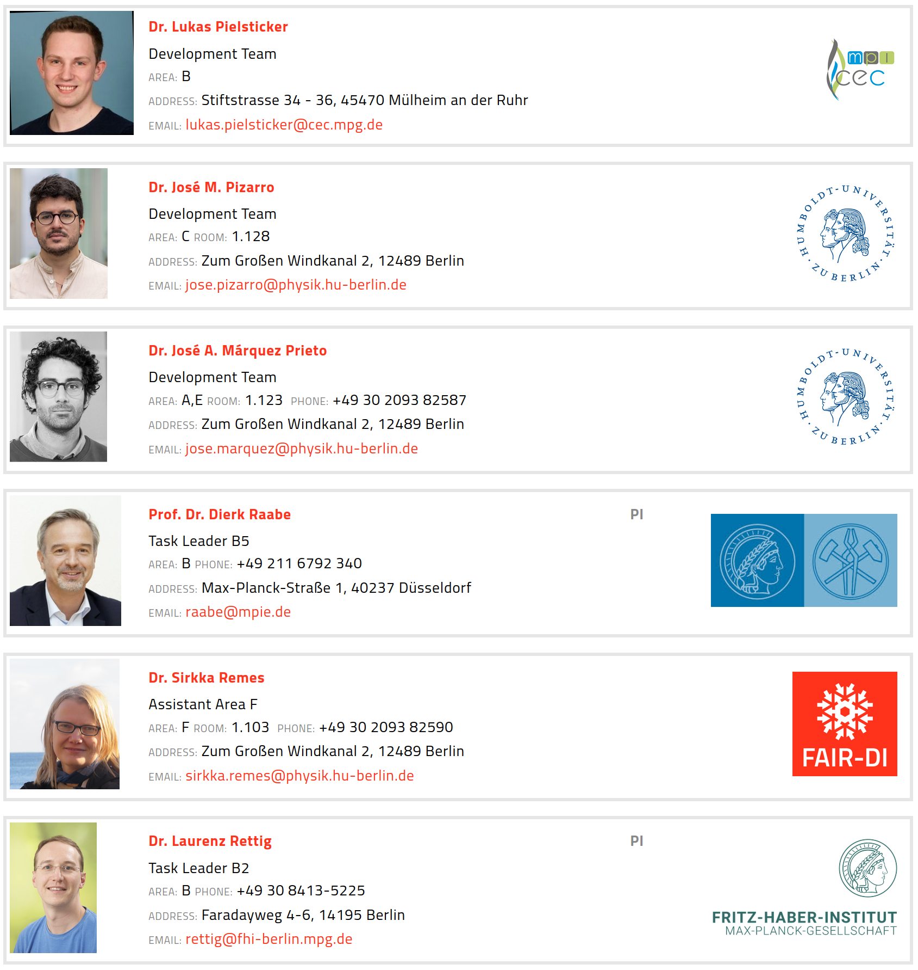

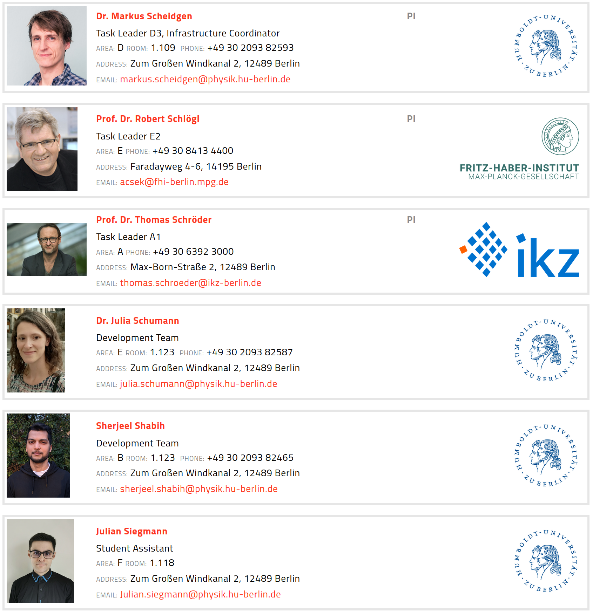
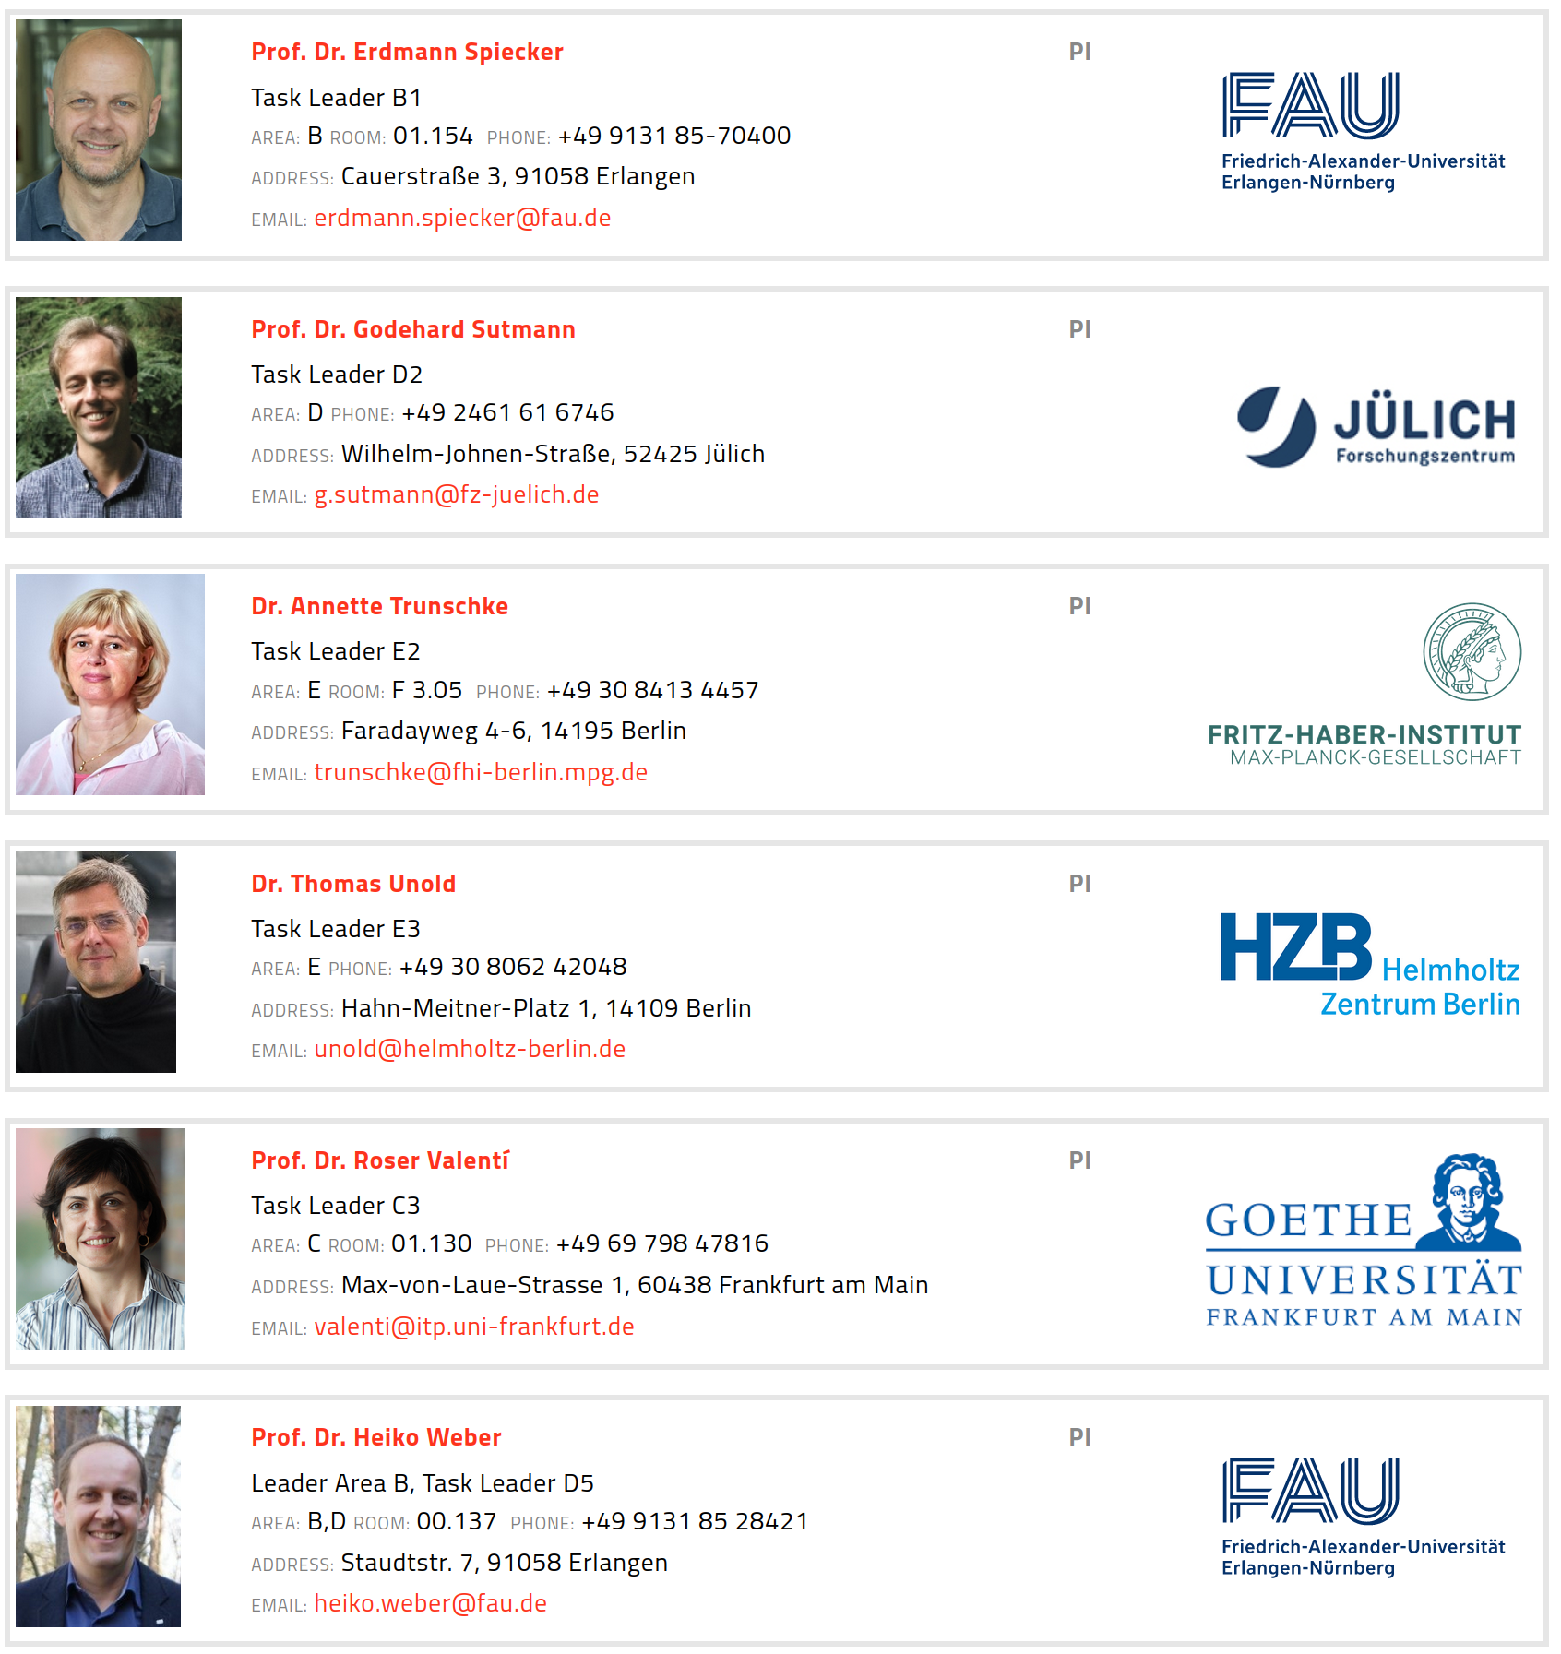
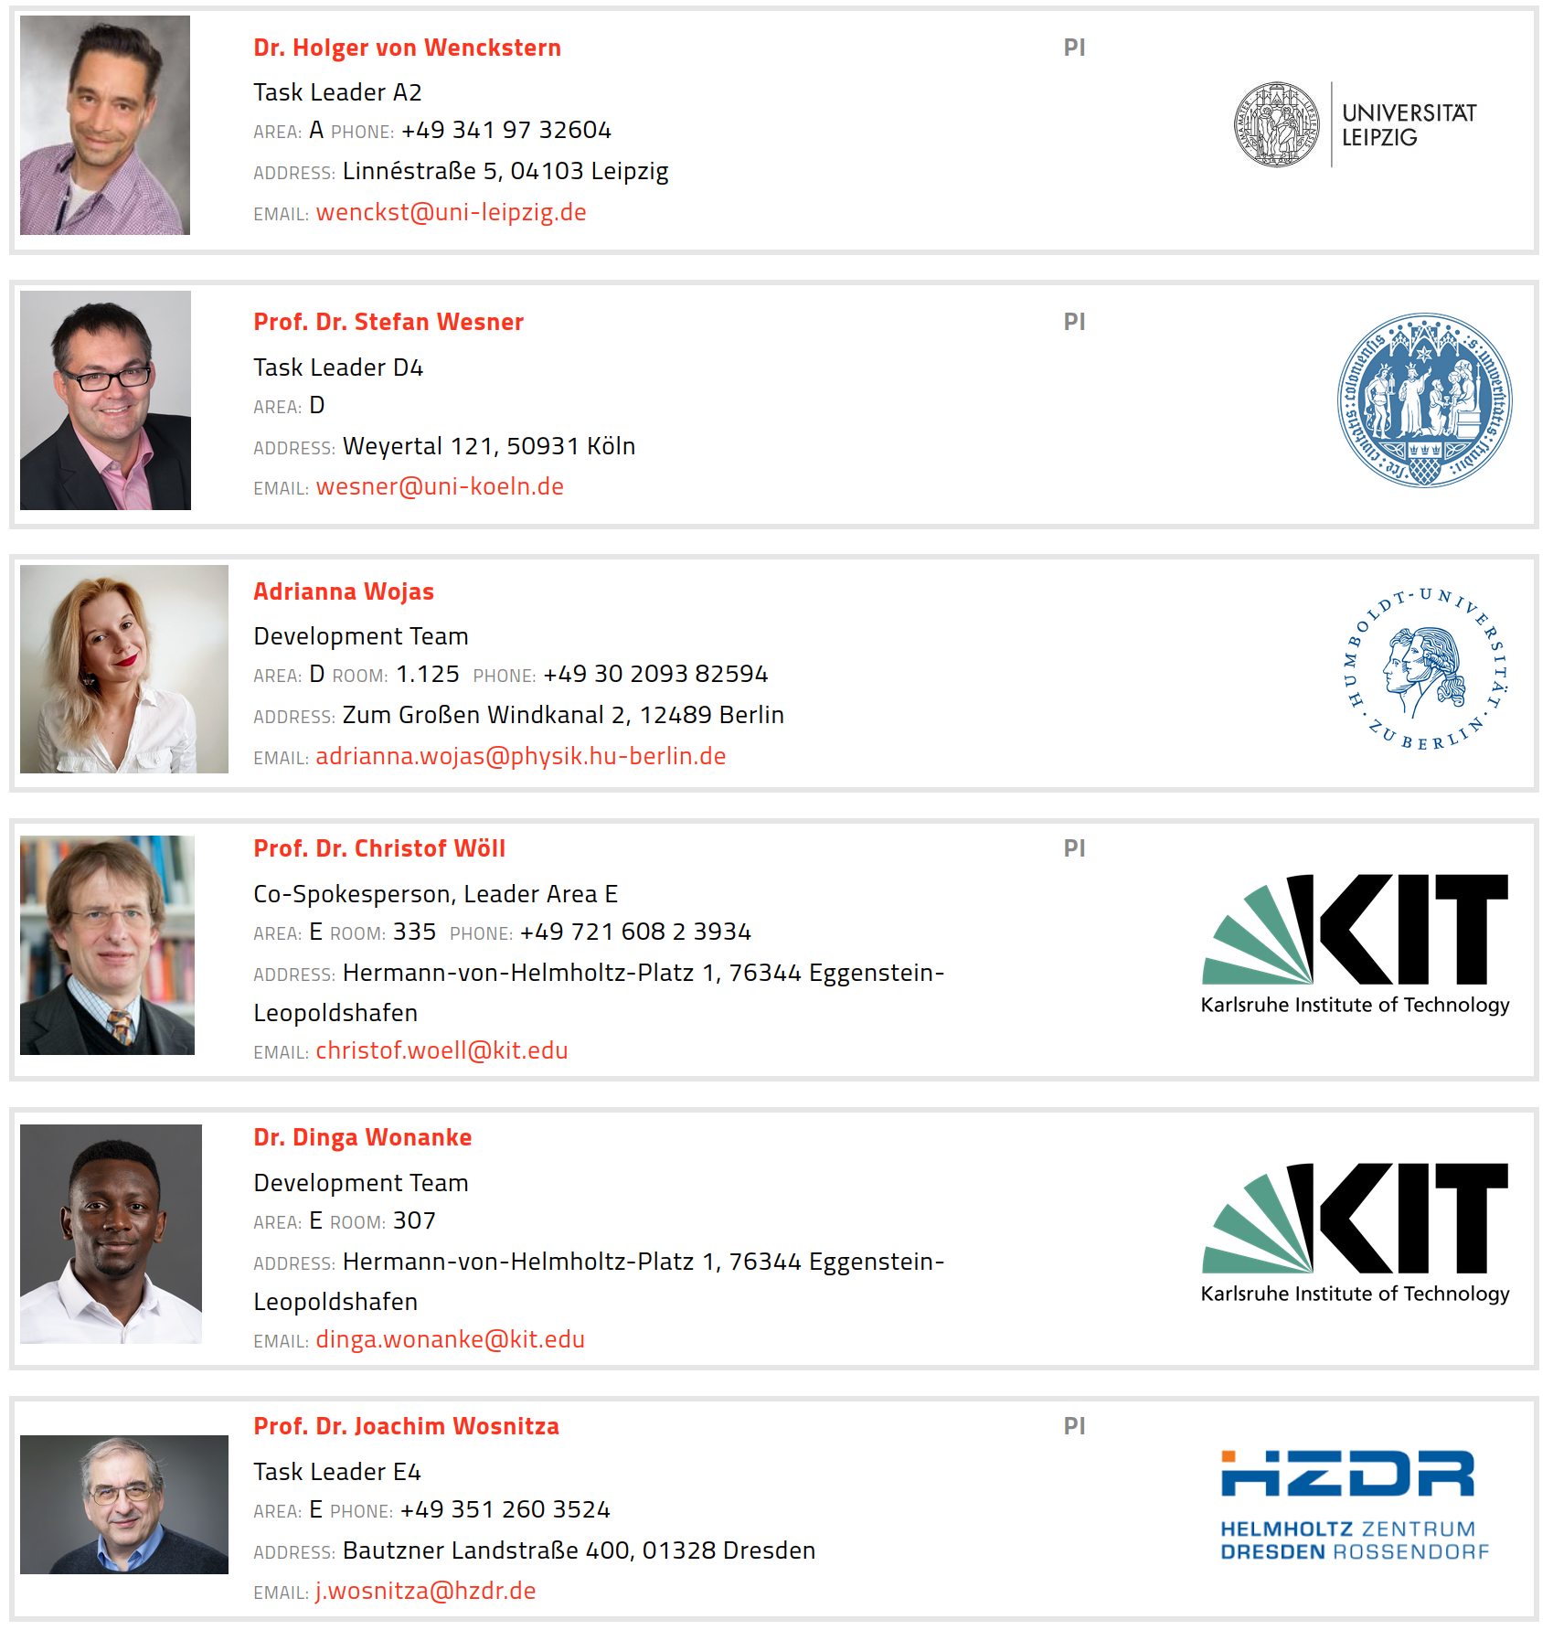
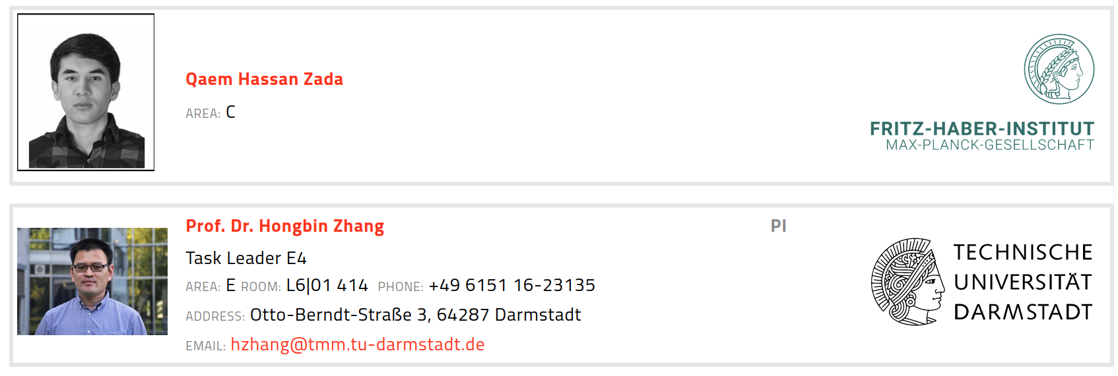
Building a FAIR data infrastructure for Materials Science research data using the NOMAD Archive & Repository.
Huge team and community-driven effort.
~40 coworkers, ~60 PIs, ~40 supporting institutions, ~30 research projects

Slide 17
FAIRmat Area C team

Slide 18

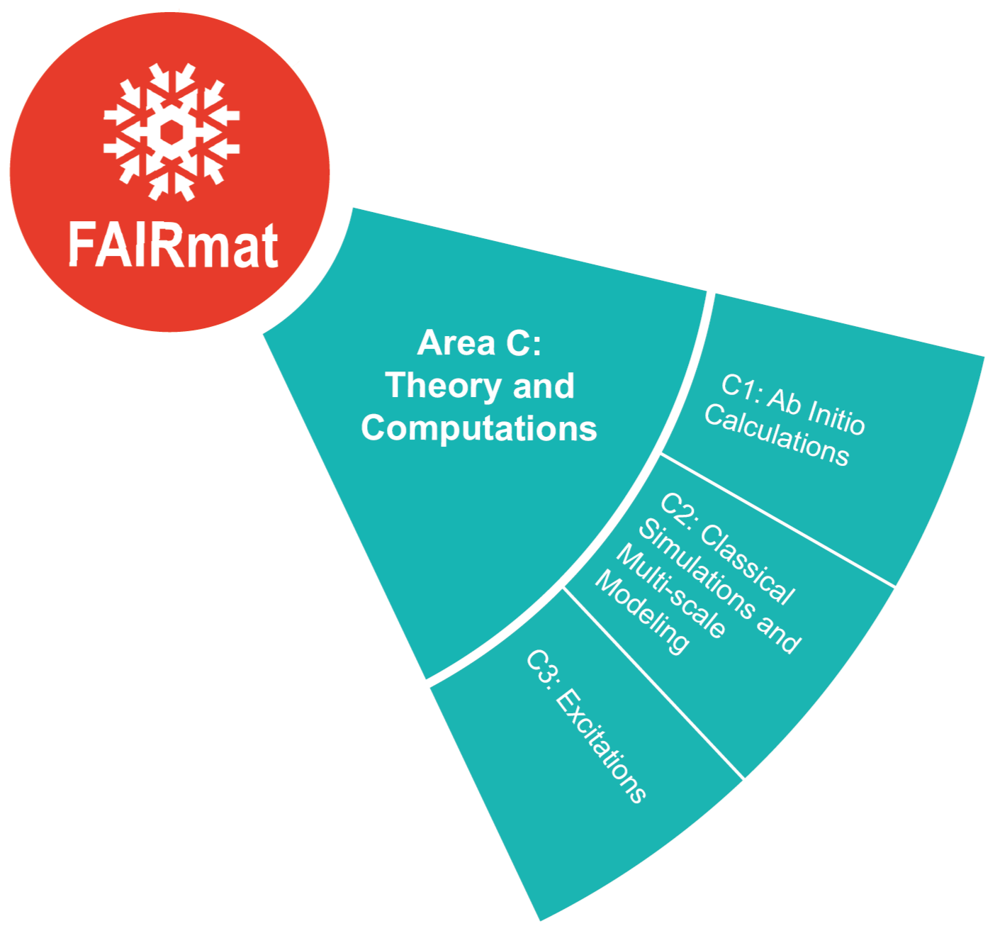
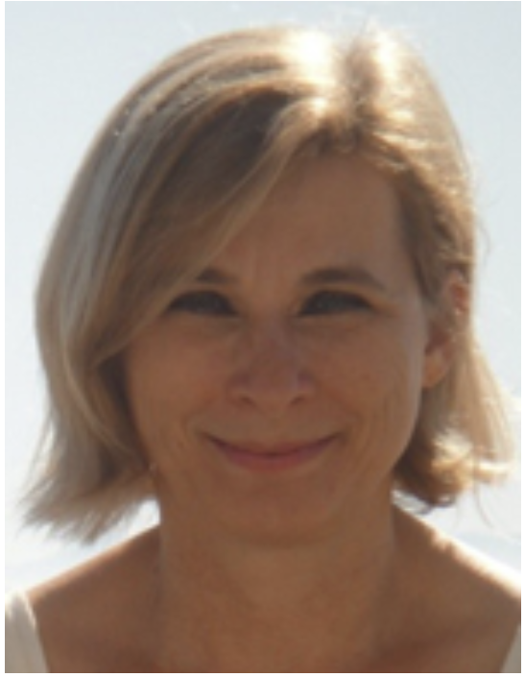
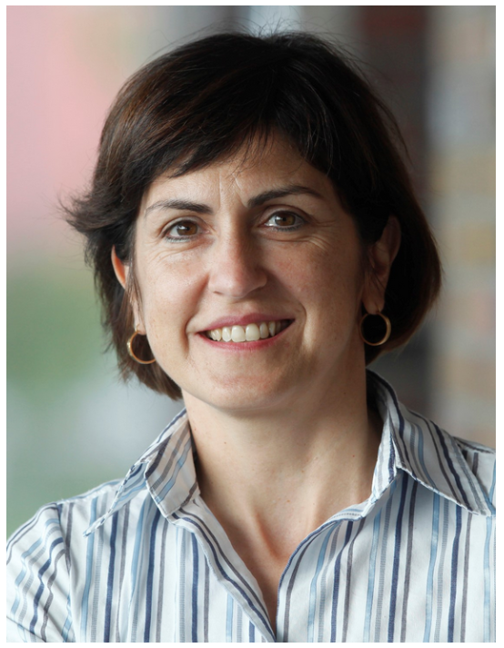









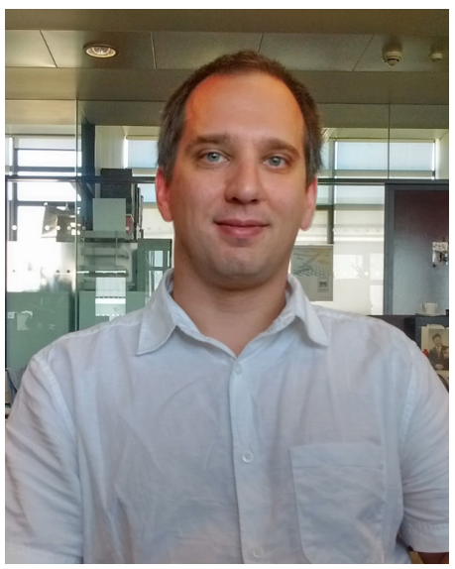

FAIRmat Area C team
Silvana Botti
Luca M. Ghiringhelli
Claudia Draxl
Roser Valentí
Miguel A.L. Marques
Nathan Daelmann
Kurt Kremer
Karsten Reuter
Joseph F. Rudzinski
+ amazing support by Area D devs and engineers
José M. Pizarro
Markus Scheidgen
Alvin Noe Ladines
Lauri Himanen
Adam Fekete

Slide 19
Schedule
Introduction to Research Data Management in Materials Science
FAIRmat and the NOMAD Archive & Repository
Hands-on NOMAD

Slide 20
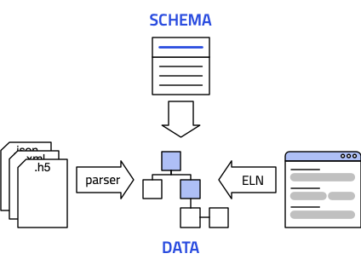
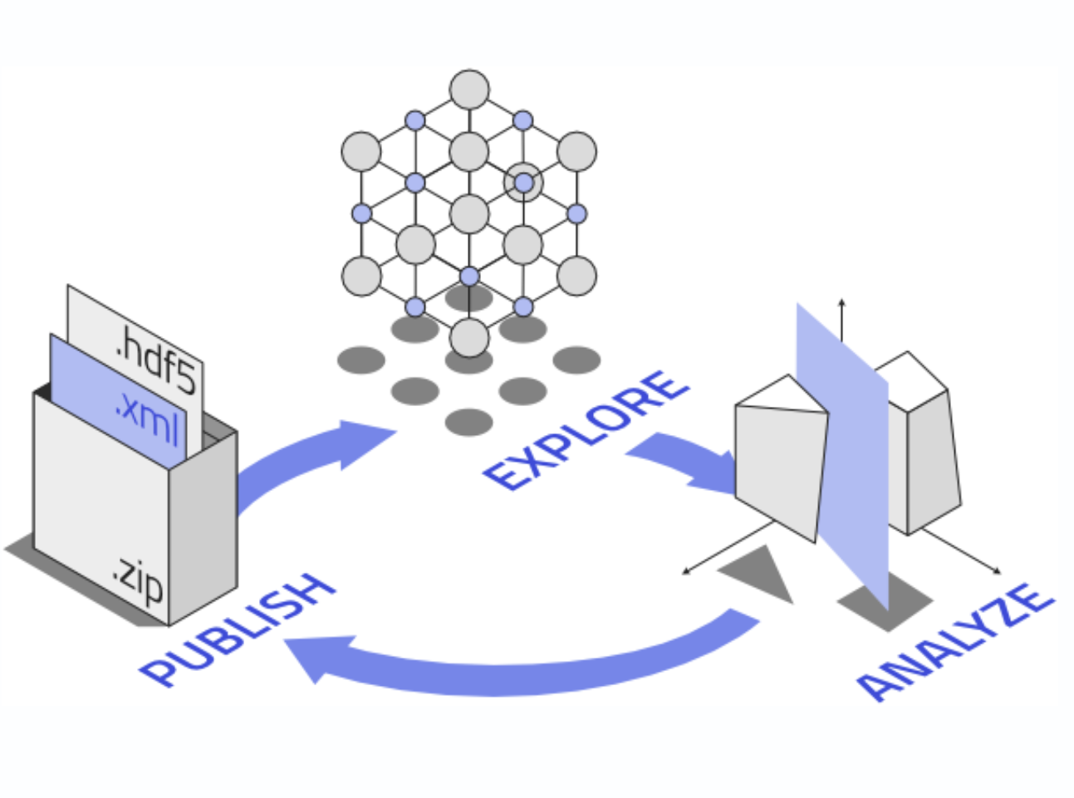
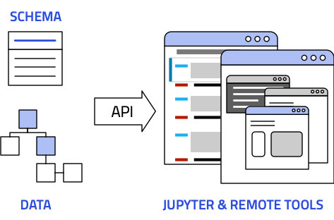
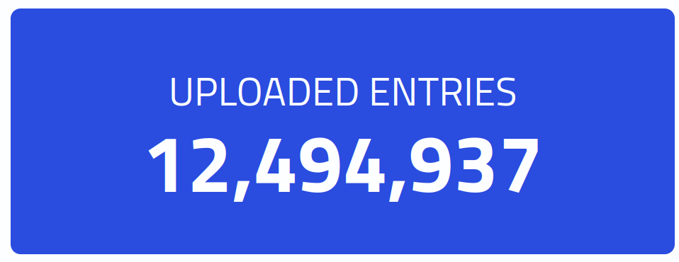
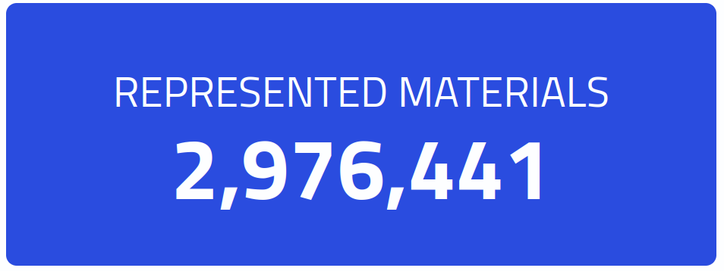
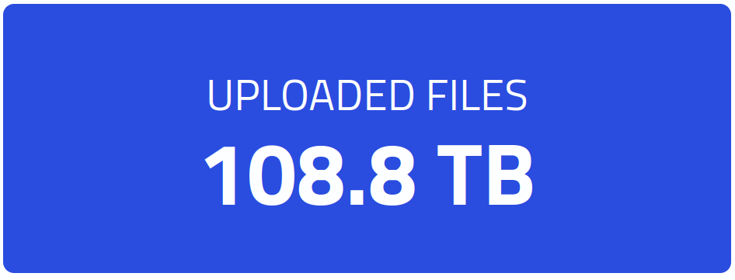
NOMAD Archive & Repository
Making materials science data
Findable
Accessible
Interoperable
Reusable
Drag and drop
Get a DOI
You control your data
Central storage or
local installation
Ready to use tools
[1] Scientific Data 3, 160018 (2016). doi: 10.1038/sdata.2016.18.

